Slide 1
Paid Social Media at The Ohio State University Wexner Medical Center
Amy Arnold, Paid Social Media Strategist

Slide 2
Creating an Ad Campaign

Slide 3
Channel Overview- Audience Selection
The Ohio State University Wexner Medical Center
 | Facebook | Twitter | LinkedIn | Instagram | TikTok
Audience | Female, ages 40+; community members, current and potential patients | Men and women, ages 25-54; peers in the medical field, other health care systems, medical journals | Healthcare services and research job function; senior and entry level; Columbus area | Women, ages 25-44; community members, current and potential patients | Women; other demographics not available on Creator Accounts
Content themes | Educational articles (owned and earned), patient stories, OSUWMC news/people, event coverage | Educational articles (owned and earned), OSUWMC news/people stories, research stories, published journal articles from faculty/staff | Stories about research/innovation, OSUWMC news, events, partnerships, faculty/staff recognition | User generated content, event coverage, environmental shots, patient stories | Educational content, trending topics, patient stories, faculty/staff stories, events

Slide 4
Healthcare Barriers
Facebook
In February, Facebook announced removal of all health care targeting terms (I.e. American Heart Association, MS awareness, etc.). This caused a shift in the way we handle Facebook campaigns; now we are focusing mostly on retargeting.
This shift also caused us to find new ways to reach our audience on Facebook. We started using interest targeting in a different way. For example, on a campaign meant to gain Living Kidney Donors we targeted people who were interested in in charity organizations.

Slide 5
Align Goals & Creative with the Correct Funnel
Awareness
Consideration
Conversion
Generate interest
Get people to seek more information
Encourage people to become patients
Lifestyle images/Videos
Infographics/ Service
Testimonials/ Offers

Slide 6
Creative Best Practices
Most of your web traffic will be from mobile. When creating ads keep this in mind.
Embrace video content. Facebook campaigns that implement video saw a 17% higher conversion lift.
Account for sound off and always add closed captions.
5-second rule – You have five seconds to capture your audience's attention
Use Text overlay in images when appropriate. It can create a more visually appealing ad, while also giving you a unique call to action.

Slide 7
Appendix

Slide 8
Facebook Ad Formats

Slide 9
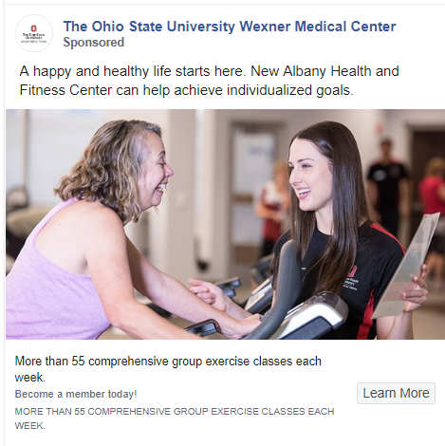
Single Image Ad
A Single image ad is the most common ad type.
Available both in image or video format, these ads will appear on both mobile and desktop.
Facebook sing image ads run directly into the feed next to posts of the users family and friends.

Slide 10
Single Image
Specs
Images
Recommended image size: 1200 x 628 pixels.
Minimum width and height: 600 pixels.
Recommended aspect ratio is between 9:16 to 16:9, but crops to 1.91:1 with a link.
Recommended image formats are JPG and PNG.
Images with 20% text or more could increase chances of failed delivery.

Slide 11
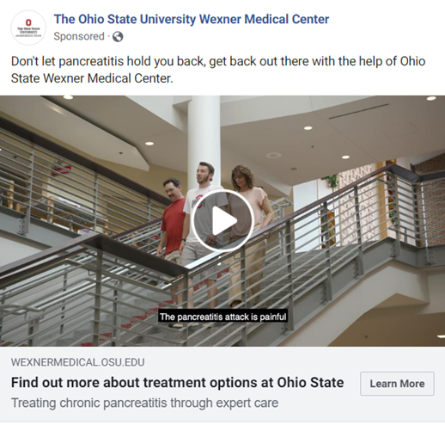
Single Video Ad
Multiple Placements
This can shape the way business tell their story
Video ads can be used in many ad formats. Feed, Carousel, Dynamic Creative, Collection, and Instant Ad Experience.
Always include sound, and captions.

Slide 12
Single Video Ad
Specs
Images
Recommended to upload the highest resolution video possible.
Minimum dimensions 600 x 315 (1.9:1 landscape) or 600 x 600 (square).
Recommended aspect ratio is between 9:16 to 16:9 (Horizontal: 16:9, Square: 1:1, Vertical: 4:5 or 2:3 and Full Portrait: 9:16).
Recommended video formats are .MP4 and .MOV
Max video file size is 4GB.
Video length recommended 60 seconds or less.

Slide 13
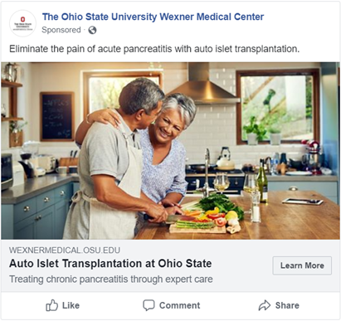
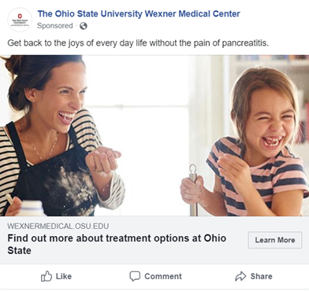
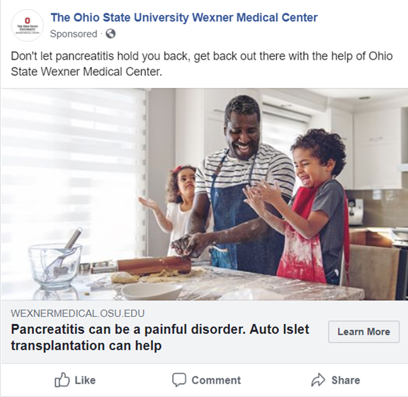
Dynamic Creative
Mobile and Desktop
Dynamic creative takes multiple ad components (such as images, videos, titles, descriptions and CTAs) and then optimizes them to deliver efficient results for each impression served.
Creating personalized variations for each person viewing your ad.
Can use 10 images or videos, 5 headlines, 5 text, 5 CTAs.

Slide 14
Dynamic Creative
Specs
Video
Videos should be a minimum 720p.
Videos should be in mp4
Build for portrait
Captions are not recommended
Recommended Length: Up to 15 seconds
Recommended Aspect Ratio: Vertical (4:5)
File size: Up to 4 GB max
Images
Recommended Image Size 1,080 x 1,080 pixels
Your image may not include more than 20% text.
File type: jpg or png
Image ratio: 1.91:1 to 4:5

Slide 15
Instant Experience
Mobile Ad only
Instant Experience is an immersive full screen ad that opens after someone clicks your ad on a mobile device.
This ad format will be added onto a static image, video, or carousel ad.
Instant Experience ads load 15x faster than mobile websites, allowing us to combat bounce rate.

Slide 16
Instant Experience
Images
Recommended image size: 1,200 x 628 pixels.
Minimum width and height of 600 pixels.f
Recommended aspect ratio is between 9:16 to 16:9, but crops to 1.91:1 with link.
Recommended image formats are JPG and PNG.
Images with 20% text or more could increase chances of failed delivery.
Specs
Video
Recommended to upload the highest resolution video possible.
Recommended aspect ratio is between 9:16 to 16:9.
Recommended video formats are .MP4 and .MOV.
Max video file size is 4GB.
Video max length is 240 minutes.
Video thumbnails with 20% text or more could increase chances of failed delivery.

Slide 17
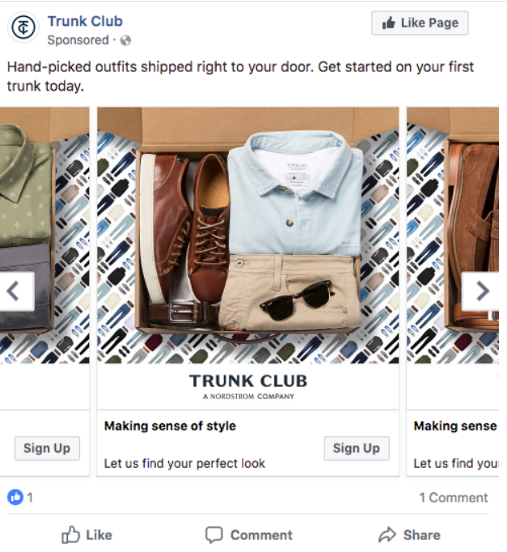
Carousel Ads
Mobile & Desktop Ad
Showcase up to 10 images or videos within a single ad, each with its own link.
Great way to tell a story for your service line. Explain a process of how Ohio State can help.
This ad we would be able to track each individual image or video unlike Dynamic creative

Slide 18
Carousel Ad
Video
Recommended resolution is minimum of 1080 x 1080.
Minimum 2 cards and max of 10 cards per Carousel Ad.
Recommended video formats are .MP4 and .MOV.
Max video file size is 4GB.
Video length is 240 minutes.
Video thumbnails with 20% text or more could increase chances of failed delivery.
Minimum number of cards: 2
Maximum number of cards: 10
Specs
Images
Recommended image size: at least 1080 x 1080 pixels
Minimum width and height of 600 pixels (minimum 254 x 133 pixels for Messenger Home Carousel Ads).
Minimum 2 cards and max of 10 cards per Carousel Ad.
Recommended ratio is 1:1.
Max image size of 30MB.
Recommended image formats are JPG and PNG.
Images with 20% text or more could increase chances of failed delivery.

Slide 19
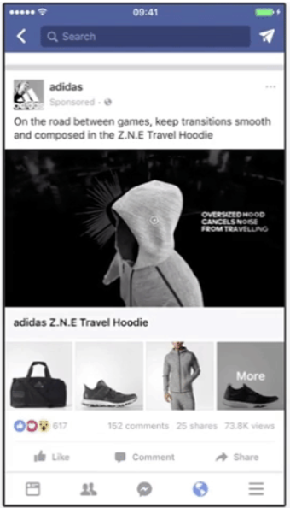
Collection Ads
Mobile Ad only
Each collection ad features a primary video or image with four smaller accompanying images below in a grid-like layout.
This pairs with Instant experience to create a seamless experience for the user.
This ad should be used when you want people to take a specific action on your website or app.

Slide 20
Collection Ad
Specs
Images
Image size: Minimum width and height of 600 pixels.
Recommended ratio is 1:1 for square and 16:9 for landscape images.
Max image size of 30MB.
Recommended image formats are JPG and PNG.
Images with 20% text or more could increase chances of failed delivery.
Video
Recommended resolution is minimum of 1200 x 628 pixels.
Recommended video formats are .MP4 and .MOV.
Max video file size is 4GB.
Video length is 120 minutes (recommended less than 2 minutes).
Video thumbnails with 20% text or more could increase chances of failed delivery.

Slide 21
Instagram Ad Formats

Slide 22
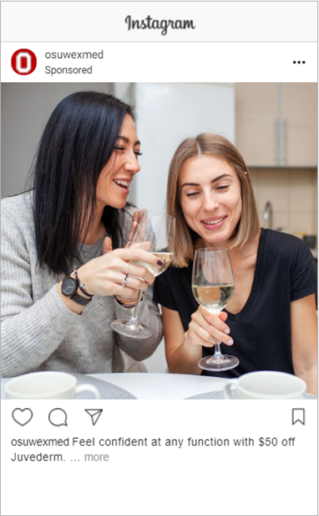
Single Image Ad
Mobile Only
Instagram has 3 different image ads you can choose between. Square, Vertical, and Landscape
Each type of Image ad can be utilized in different ways.
All of Instagram ads are optimized for mobile only. Since Instagram is a mobile app.
Notes:
Think about what you are visually trying to say with the image

Slide 23
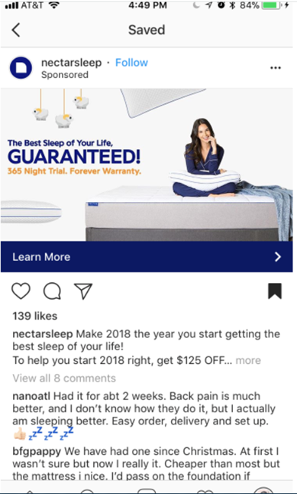
Landscape Image Ad
Mobile Only
Instagram landscape images are typically wider and do not take up the traditional full square of the Instagram post.
Landscape images stand out compared to the standard Instagram format, and can be uniquely used to show a wider image.

Slide 24
Landscape Image Ad
Specs
Landscape image ad dimensions and guidelines
Recommended image ad size: 1200 x 628 pixels.
Minimum resolution: 600 x 315 pixels.
Recommended aspect ratio: 1.9:1.
All file formats should be either JPG or PNG.
All image files are 30MB max.
The caption maximum length is 2,200 characters, but 125 is recommended.

Slide 25
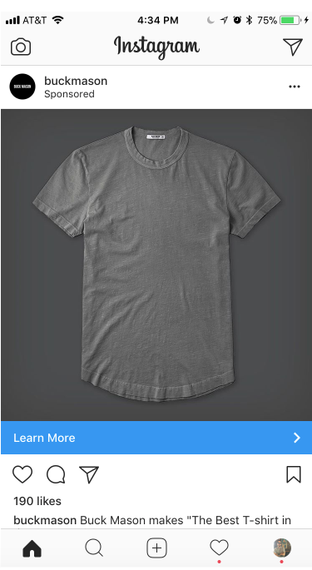
Square Image Ad
Mobile Only
Instagram square image focuses on width, but takes up more space of the overall post layout than landscape.
The square doesn’t use all the space provided per post and typically is used for portrait-style images.

Slide 26
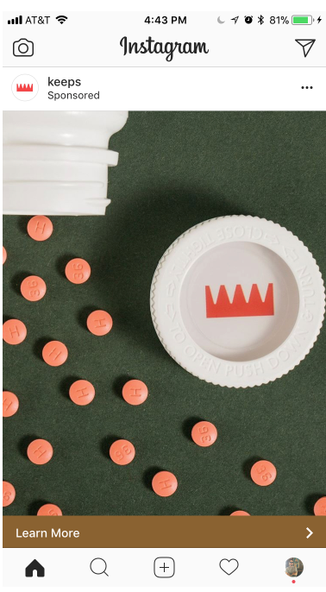
Vertical Image Ad
Mobile Only
Possibly the most popular photo size organically is the vertical, or portrait image.
One of the reasons this image size is so popular is due to our phones automatically shooting in this style. Thus making it the easiest to upload.

Slide 27
Vertical Image Ad
Specs
Vertical image ad dimensions and guidelines
Recommended square image ad size: 1080 x 1350 pixels.
Minimum vertical image ad size: 600 x 750 pixels.
Aspect ratio: 4:5.

Slide 28
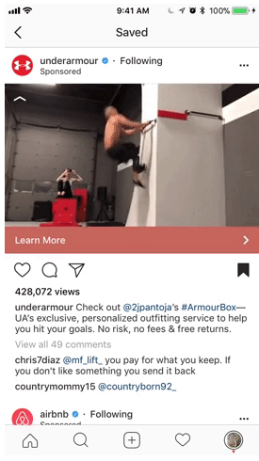
Landscape Video Ad
Specs
This style of video allows users to showcase a more cinematic approach to video–mostly viewed on mobile–for its followers.
Instagram landscape videos are typically wider and do not take up the traditional full square of the Instagram post.

Slide 29
Landscape Video Ad
Specs
Landscape video ad specs
Minimum resolution: 600 x 315 pixels.
Aspect ratio: 1:91:1.
Recommended video formats include MP4 and MOV.
Max video size for all formats is 4GB.
Max video length for all formats is 120 seconds.
Video max frames is 30fps for all formats.

Slide 30
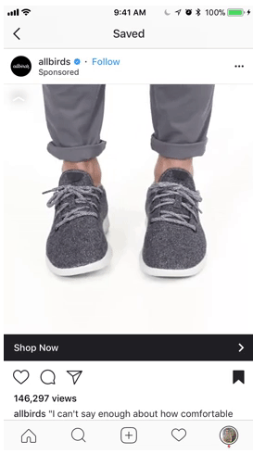
Square Video Ad
Mobile Only
Instagram square video focuses on width, but takes up more space of the overall post layout than landscape.
The square doesn’t use all the space provided per post and typically is used for portrait-style images.

Slide 31
Square Video Ad
Specs
Square video ad specs
Instagram square video ad minimum resolution is 600 x 600 pixels.
The proper aspect ratio is 1:1.

Slide 32
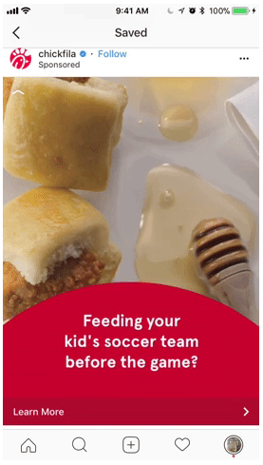
Vertical Video Ad
Mobile Only
As you’re likely gathering, organic and paid formats are similar. And for vertical video ads, make sure to pay attention to the resolution and aspect ratio changes.

Slide 33
Vertical Video Ad
Specs
Vertical video ad specs
Instagram vertical video ad minimum resolution is 600 x 750 pixels.
The proper aspect ratio is 4:5.

Slide 34
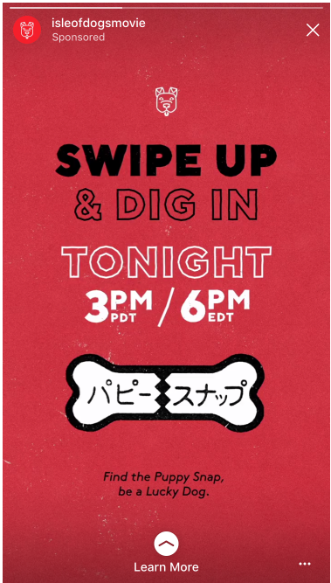
Instagram Stories Ad
Mobile Only
Instagram Stories have a lot of features that make single image ads or single image ads ideal for your marketing campaign.
With GIFs, stickers and marker tools, you can easily direct users to clicking or swiping to find more information.
Additionally, advertisers may want to limit overlay text on images as Facebook’s Ad Manager could reject your image or video.

Slide 35
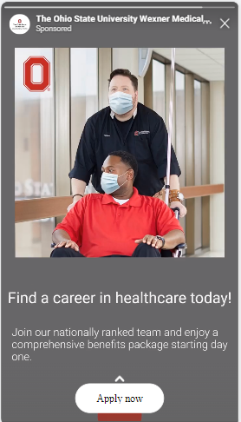
Instagram Stories Ad
Specs
Instagram Stories ad image dimensions
Recommended resolution: 1080 x 1920 pixels.
Minimum resolution for Stories ads: 600 x 1067 pixels.
Aspect ratio: 9:16.
All formats should be either JPG or PNG.
Max image size is 30MB.
Instagram Stories video ad specs
Recommended resolution: 1080 x 1920 pixels.
Aspect ratio: 9:16.
All formats should be either MP4 or MOV.
Max video size is 4GB.
Must have a resolution minimum of 720p.

Slide 36
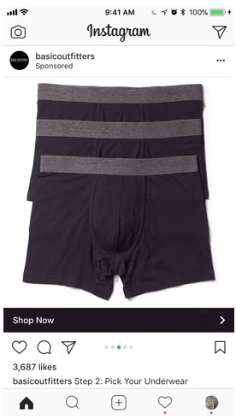
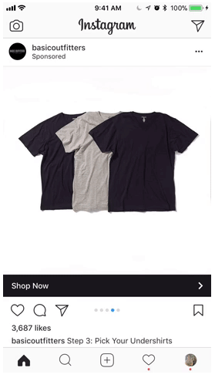
Carousel Ad
Specs
This type of ad format allows brands to showcase multiple images or videos in one single ad.
It’s truly the best bang for your Instagram ad buck.
If you’re like anyone else on Instagram, you flip through content at blinding speeds. Why not try to keep users around for awhile with more than one piece of visual content?

Slide 37
Instagram Carousel Ad
Specs
Carousel video ad specs
Minimum resolution: 600 x 600 pixels.
Maximum resolution: 1080 x 1080 pixels.
Aspect ratio is 1:1.
All formats should be MP4.
Max video size is 4GB per video/card.
Max video length for is 60 seconds.
Instagram allows 2-10 videos/cards per ad.
All video needs a thumbnail image, 1:1 ratio
Carousel ad image dimensions
Recommended resolution: 1080 x 1080 pixels.
Aspect ratio: 1:1.
All formats should be either JPG or PNG.
Max image size is 30MB per image/card.
Instagram allows 2-10 images/cards per ad.

Slide 38
Twitter Ad Formats

Slide 39
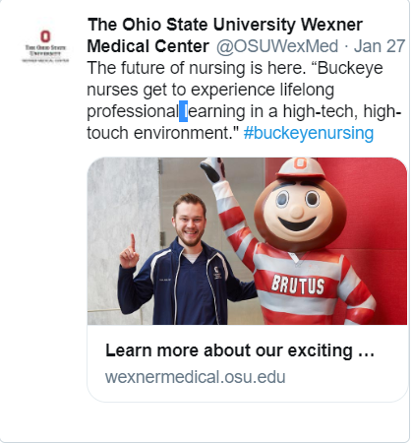
Single Image Ad
Multiple Placements
Reach a new Twitter audience or spark engagement from your existing followers with Promoted Tweets.
In feed, promoted Tweet to engage with audience in their timeline.
All promoted Tweets are labeled as such.

Slide 40
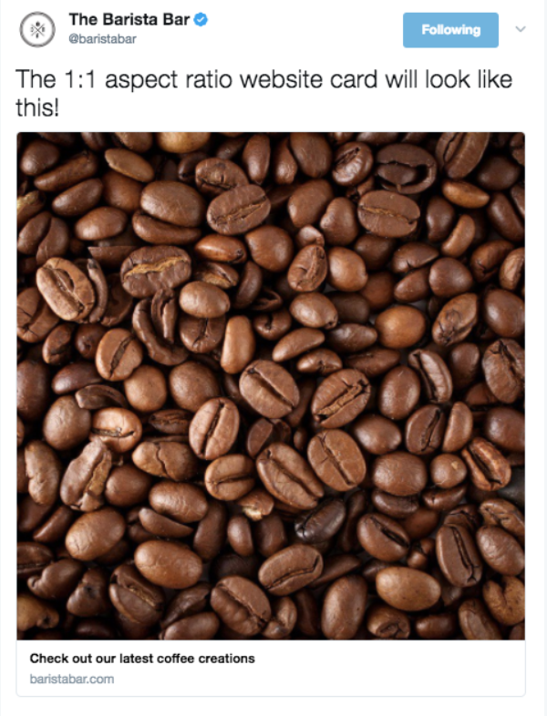
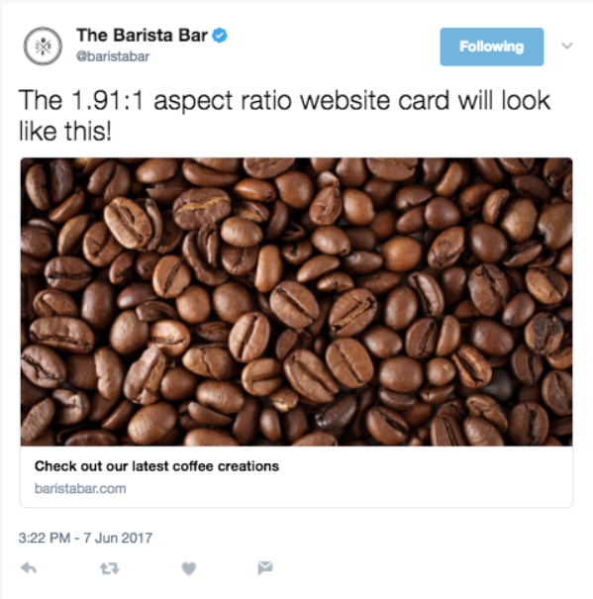
Single Ad Image (Promoted Tweet)
Specs
Image size: 800 x 418 pixels for 1.91:1 aspect ratio, 800 x 800 pixels for 1:1 aspect ratio (max 3mb)
Aspect Ratio: 1.91:1 or 1:1.
PNG and JPEG are recommended.

Slide 41
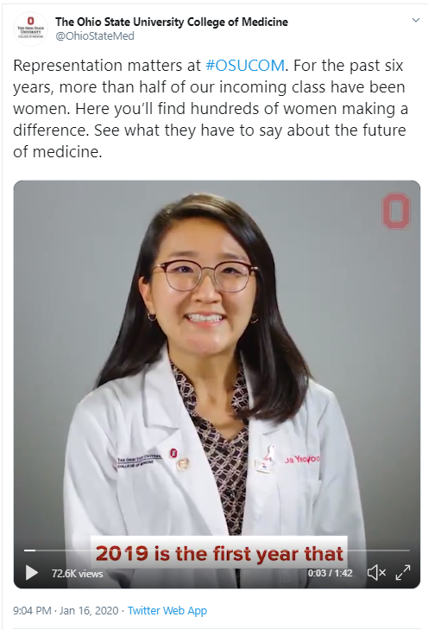
Single Video Ad (Promoted Video)
Multiple Placements
In-feed, auto-playing video to engage users in their timeline
This can shape the way business tell their story
Always include sound, and captions.

Slide 42
Single Ad Video
Specs
Landscape recommended dimensions: 320 x 180 (256K bitrate), 640 x 360 (768K bitrate) and 1280 x 720 (2048K bitrate).
Portrait recommended dimensions: 240 x 240 (256K bitrate), 480 x 480 (768K bitrate) and 640 x 640 (1024K bitrate).
Minimum dimensions for both is 32 x 32.
Maximum dimensions for both is 1280 x 1024.
Aspect ratios are between 1:2.39 to 2.39:1.
Max file size is 512MB.
Recommended video formats are .MP4 for web and .MOV for mobile.
Video length max is 140 seconds.
Video max frames 40fps.
Gifs not recommended for Website card
Captions are mandatory

Slide 43
LinkedIn Ad Formats

Slide 44
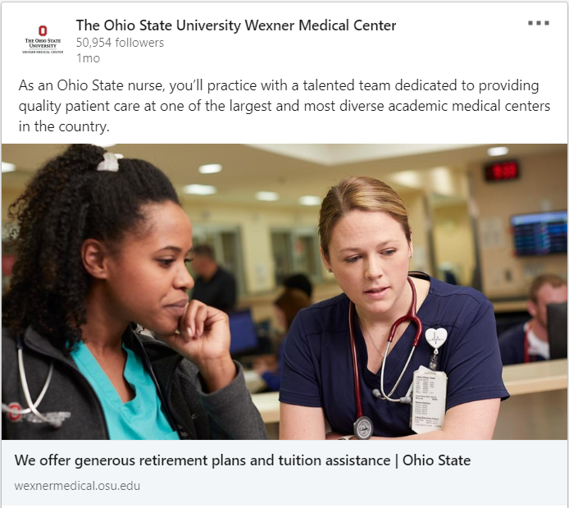
Sponsored Content Image
News Feed
These native advertisements live directly within the LinkedIn feed, appearing alongside content LinkedIn members curate for themselves.
Raising awareness of company events or initiatives
Increasing qualified traffic to posts or pages.

Slide 45
Sponsored Content Image
Specs
Recommended size for images or links: 1104 x 736 pixels
Appears at 552 x 289 pixels
Maximum size for shared images only: 1104 x 736
Image types include: JPNG, JPG or GIF.
The image will appear slightly vertically cropped on mobile, following our recommended sizes here.

Slide 46
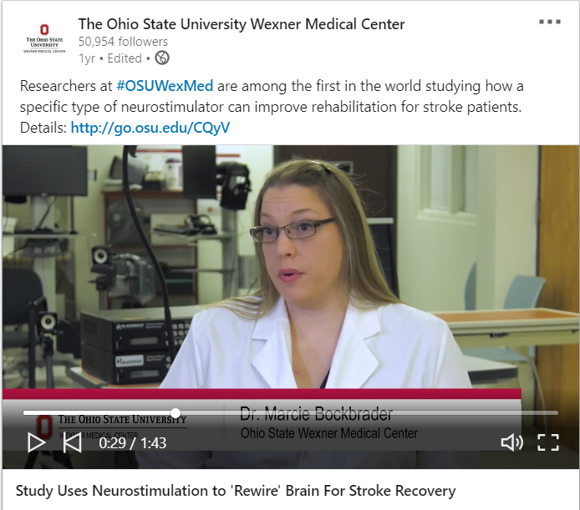
Sponsored Content Video
News Feed
These native advertisements live directly within the LinkedIn feed, appearing alongside content LinkedIn members curate for themselves.
Building brand awareness by telling rich, visual stories in the premium context of LinkedIn
Driving qualified traffic to your desktop or mobile website

Slide 47
Sponsored Content Video
Specs
Required dimensions are: 480 x 360 (360p), 640 x 360 (360p wide), 640 x 480 (480p), 960 x 720 (720p), 1280 x 720 (720p wide), 1440 x 1080 (1080p), 1920 x 1080 (1080p wide)
Maximum file size is 200 MB
The accepted video format is .MP4
Frame rate must be less than 30fps.

Slide 48
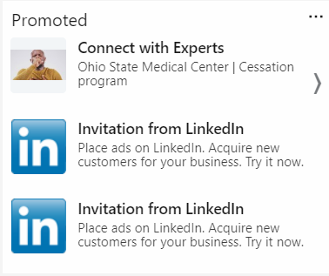
Text Ads
Side Rail
This is LinkedIn’s pay-per-click (PPC) platform, with ads that display on the side rail or inline.
Targeting highly specific B2B audiences
Driving traffic to your website or specific landing pages
Attracting quality job candidates

Slide 49
Text Ad
Specs
100x100 pixels,
jpg or png file
2MB or smaller.

